Slide 1
Music to Visual Cues: Exploring How AI Can Communicate A Song Visually
Technical Paper Presentation
Sabika Amalina, Yogie Permana, Natalia Sampere
DM 2586 Generative AI for Media Technology and Interaction Design March 2025

Slide 2
Contents
Introduction & Background
Method
User Testing
Results & Discussion

Slide 3
Introduction
& Background

Slide 4
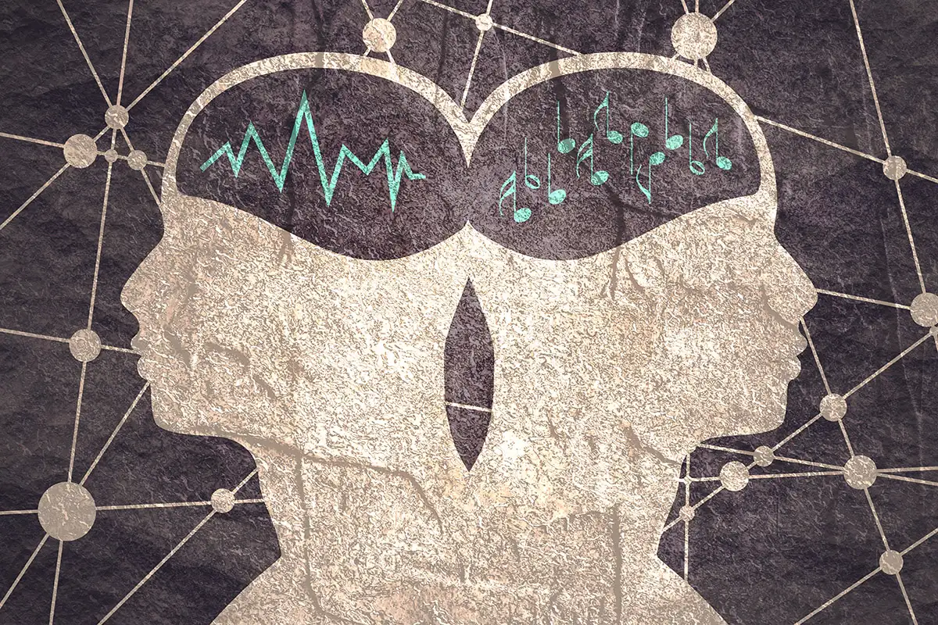
Study Overview
This study focuses on how artificial intelligence (AI) can be used to generate visual representations of music by analyzing auditory features.
RQ1: To what extent can AI effectively translate core auditory features—such as rhythm, melody, and harmony—into visual representations that encapsulate the expressive and structural characteristics of music?
RQ2: How do these multimodal translations influence users’ auditory experience, particularly in terms of emotional engagement and cognitive interpretation?

Slide 5
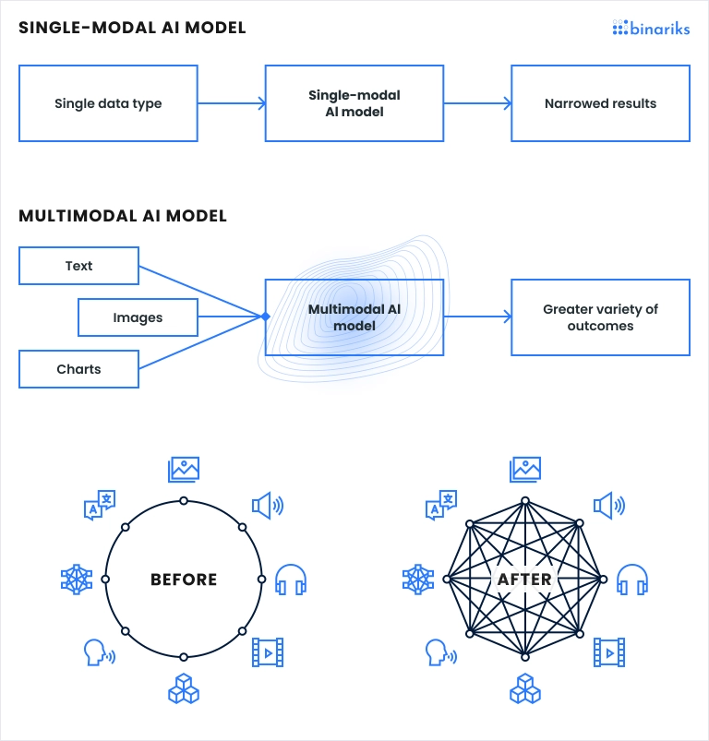
Multimodal AI
In the context of music, multimodal AI can take features from the auditory domain, such as:
tempo
melody
rhythm
and convert them into visual representations. These visuals can then act as an alternative, or complementary, way to experience music.

Slide 6
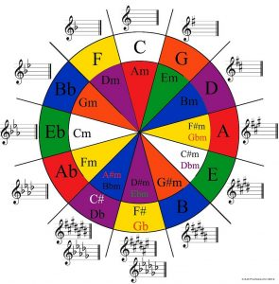
Music Perception and Multisensory Experience
Music engages not only the auditory system but also motor control and visual imagery centers in the brain.
Synesthesia and Music: Synesthesia is a phenomenon where people experience cross-modal sensory perceptions, such as seeing colors when they hear music (Chromesthesia or sound-to-color synesthesia).

Slide 7
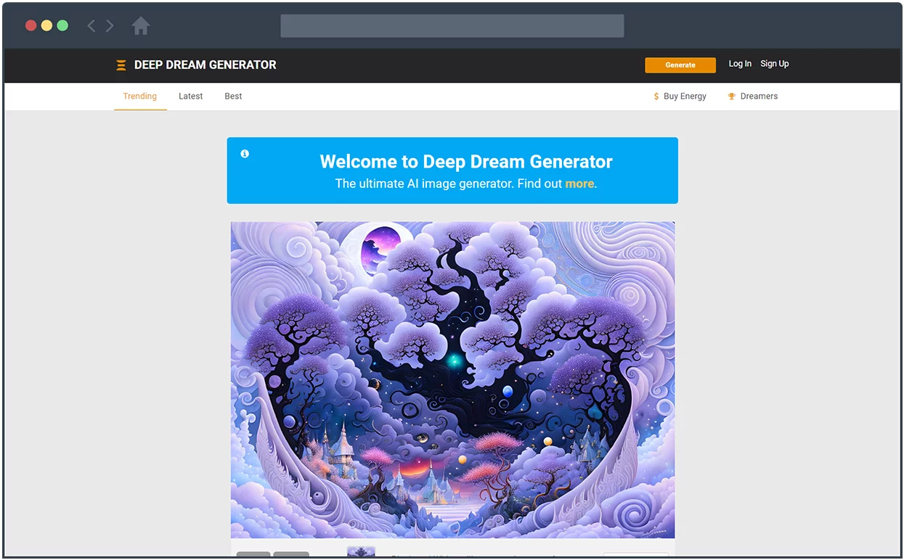
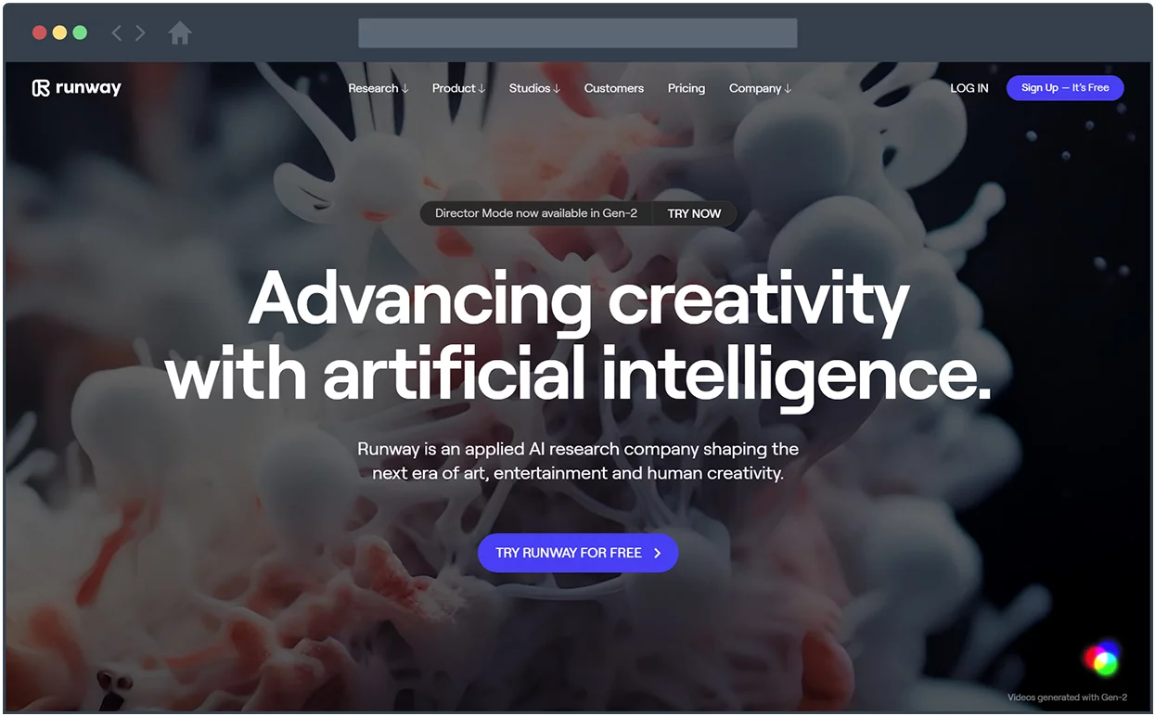
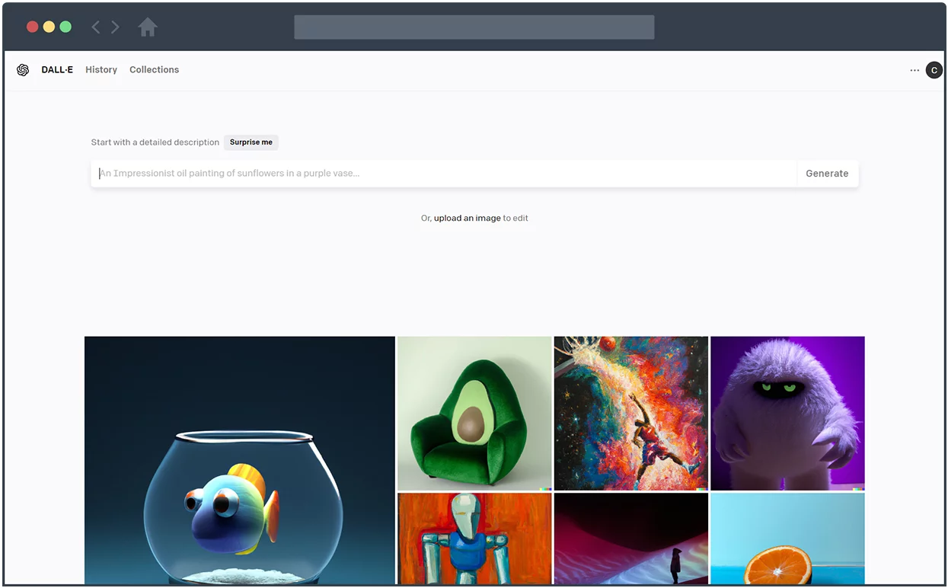
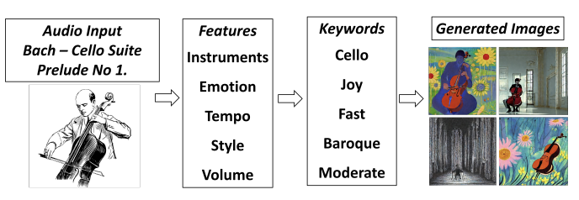
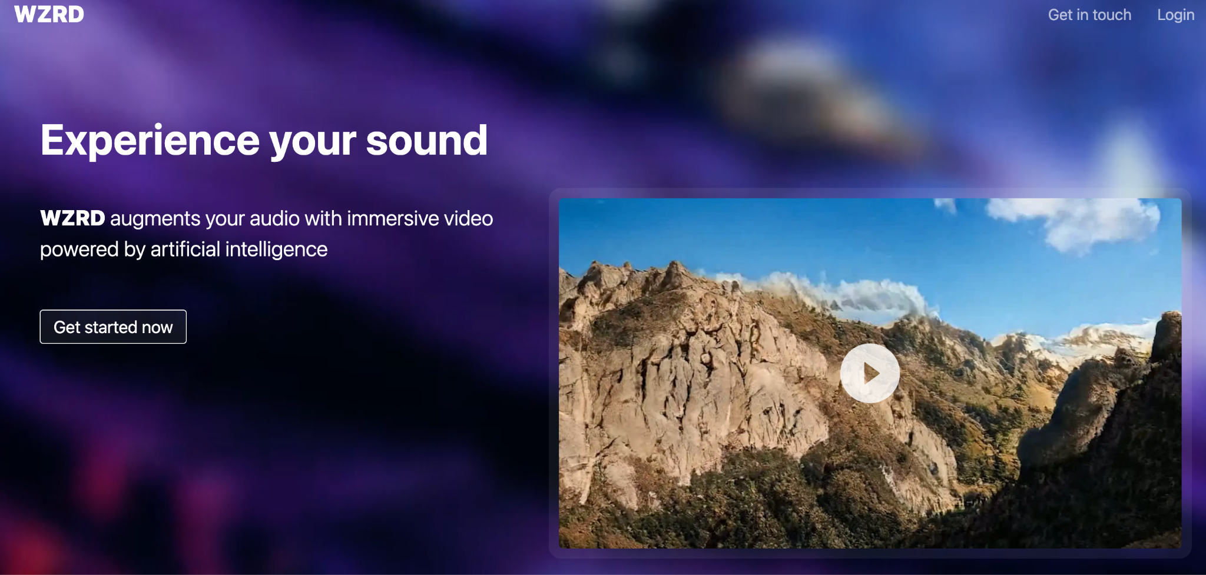
AI in Music Visualization
AI tools for music artwork creation
Goal:
To bridge the auditory and visual experiences, providing a new, immersive way for audiences to 'see' music.
To explore new dimensions of artistic expression and efficiency.

Slide 8
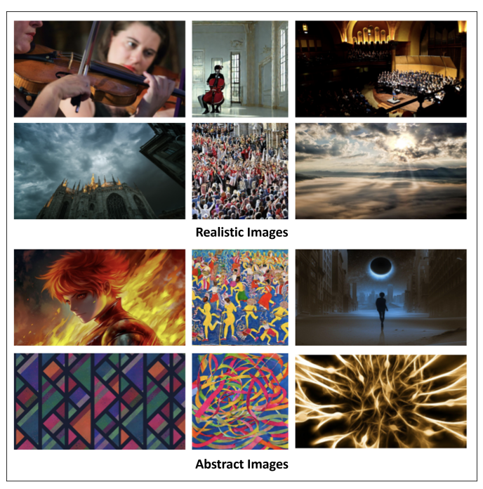
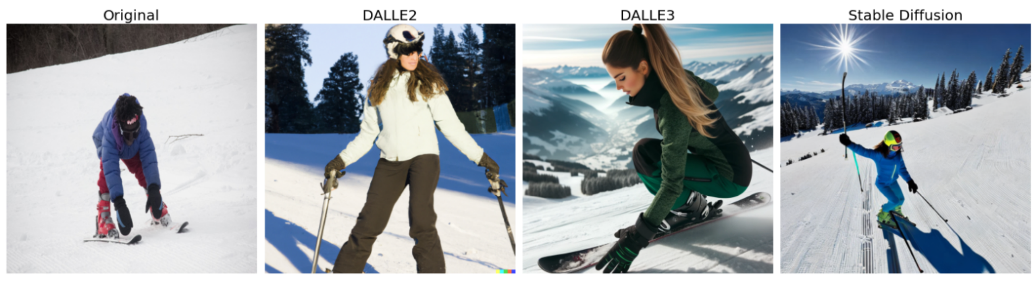
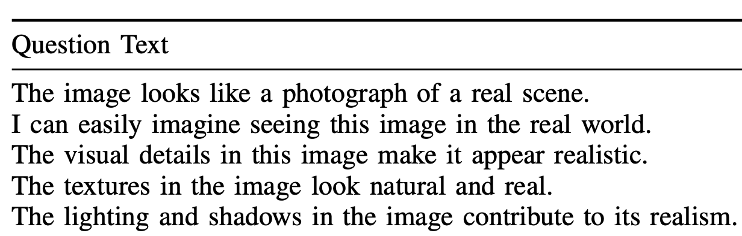
AI-Generated Art and Its Evaluation
Based on previous research, is abstract imagery particularly effective in translating musical elements into visual form?
How do we evaluate the music visualization generated by AI?

Slide 9
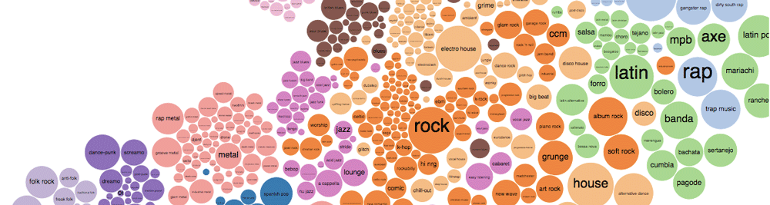
Implications
1. Set of Musical Genres
Previous studies have primarily focused on a limited set of musical genres, such as Classical, Pop, and Jazz, when evaluating AI models for emotion recognition in music.
This study incorporates a more extensive dataset comprising ten distinct genres.
2. Style Classifications of AI-Generated Images
Previous research has largely categorized AI-generated images into broad stylistic classifications such as abstract and realistic.
This study identifies four distinct visual styles—Abstract, Imaginary Place, Diffuse Clouds, and Album Cover.

Slide 10
Method

Slide 11
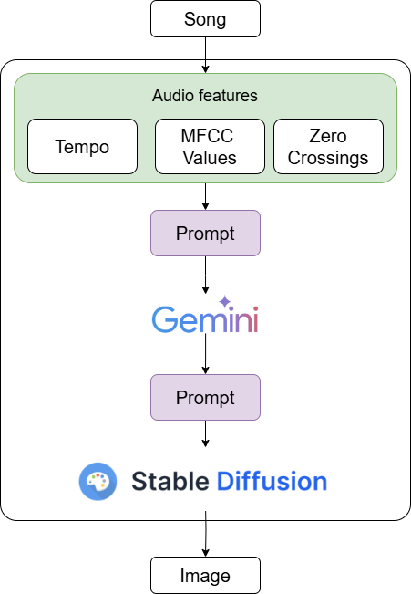
A. System Design
Two approaches
Automatic: generation of images relies entirely on the system’s pre-programmed flow, with the only user input being the selection of the song.

Slide 12
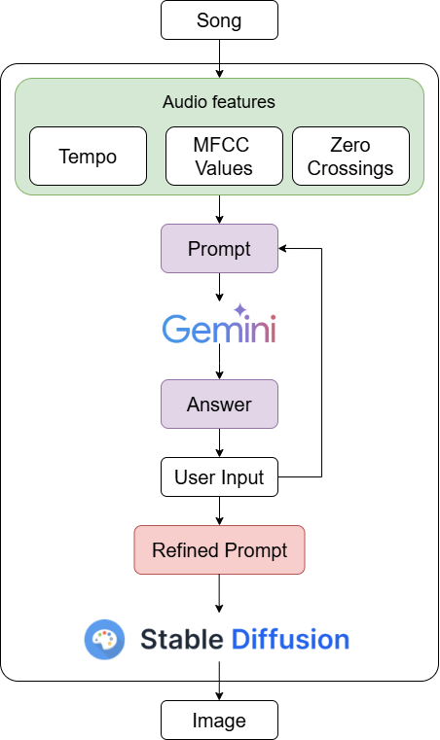
A. System Design
Two approaches
Semi Automatic: the system does not generate images fully autonomously, but instead requires user input to refine its results

Slide 13


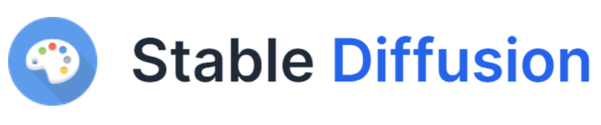
B. Models & Features selection
Models
Audio Features
Tempo
Sum of Zero-Crossings
Mel-Frequency Cepstral
Coefficient (MFCC)

Slide 14
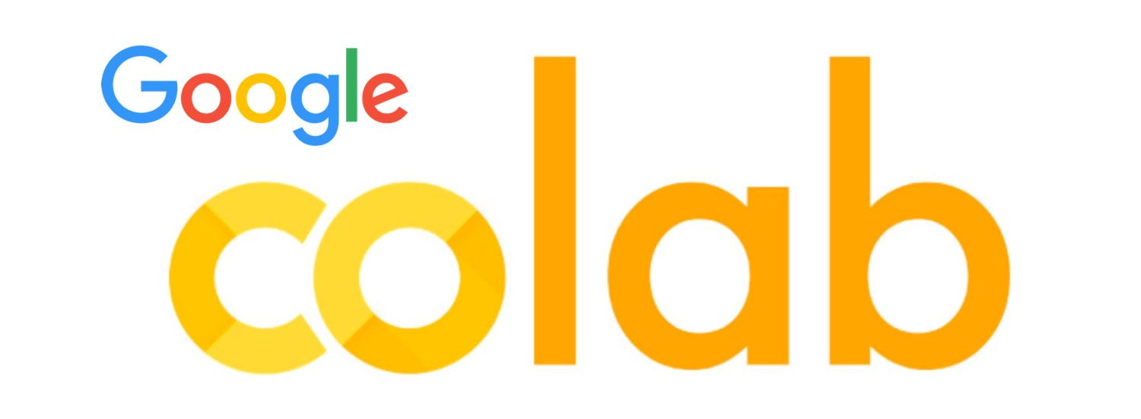
C. Implementation process
DEAM dataset
Python3
Songs
(snippets < 20 s)
Librosa
Audio Features

Slide 15
User Testing

Slide 16
User Test Objectives
This test evaluates how well AI-generated visuals represent the essence of a song. We have chosen four distinct visual styles to assess their effectiveness:
Abstract Style – Uses shapes, colors, and motion to convey emotions.
Imaginary Place Style – Represents music through dreamlike or surreal landscapes.
Diffuse Clouds Style – Captures music in soft, atmospheric forms.
Album Cover Style – Mimics bold, genre-based album artwork.
We aim to:
Identify which style best represents each song.
Understand how different users interpret music visually.
Explore whether users prefer alternative styles.

Slide 17
Target Audience & Testers
The study included 23 testers
We recruited casual music listeners, avid listeners, musicians, and visual artists.
A background question in the test will help segment responses based on:
Music engagement level (casual listener, avid listener, musician).
Visual arts/design background (professional, hobbyist, or no background).

Slide 18
Test Execution (Google Forms-based, Unmoderated)
Each participant needs to:
Listen to a song via a provided Google Drive link.
View four AI-generated images representing different styles.
Select the image that best represents the song.
(Optional) Provide a brief reason for their choice.
Repeat for multiple songs (10 total).
Answer a final question about whether they feel these styles are sufficient or if they prefer another approach.

Slide 19
Results & Discussion

Slide 20
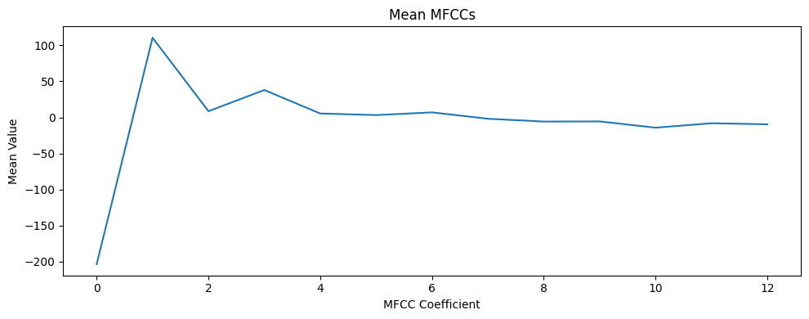
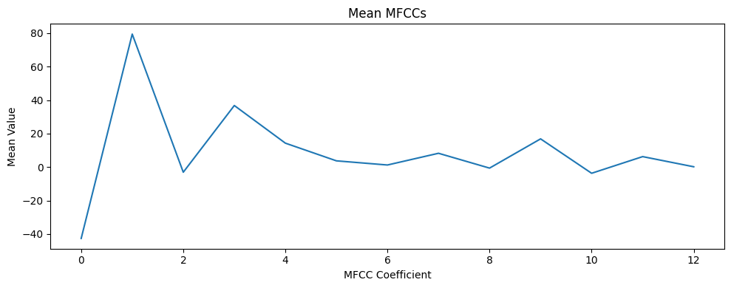
Examples with Blues & Pop songs
Blues
Pop
Tempo: 89 BPM
Zero-crossings: 19900
MFCC:
Tempo: 172 BPM
Zero-crossings: 43200
MFCC:

Slide 21
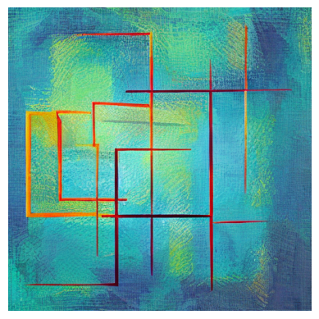
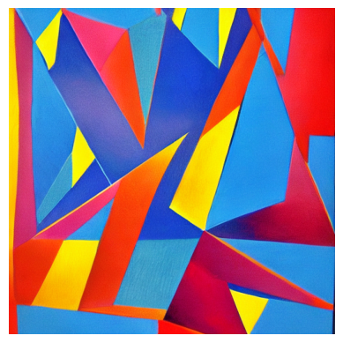
Examples with Blues & Pop songs
Blues
Pop
“Calm, Relaxed, Neutral, Subdued”
“Energetic, Excited, Upbeat, Driving”

Slide 22
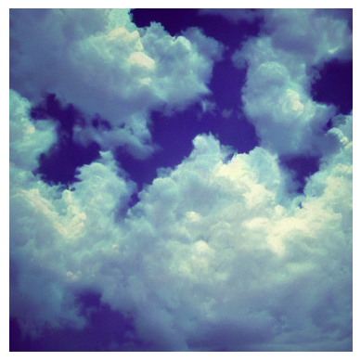
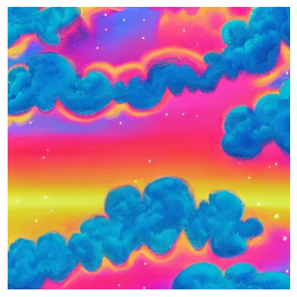
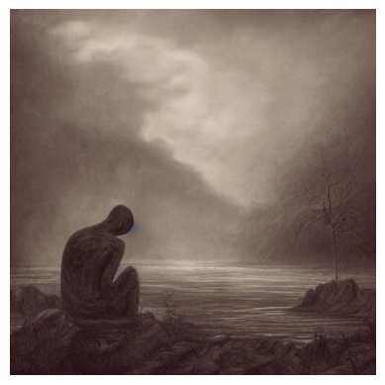
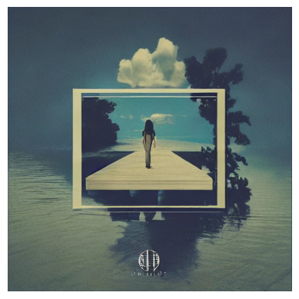
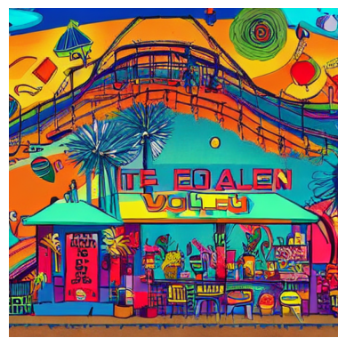
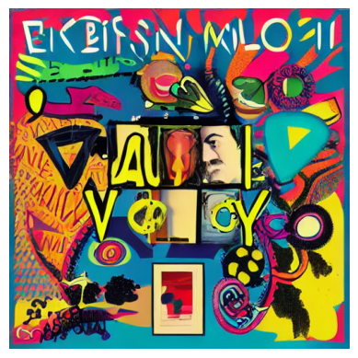
Examples with Blues & Pop songs
Blues
Pop
Abstract
Clouds
Abstract
Clouds
Imaginary Place
Album
Cover
Imaginary Place
Album
Cover

Slide 23
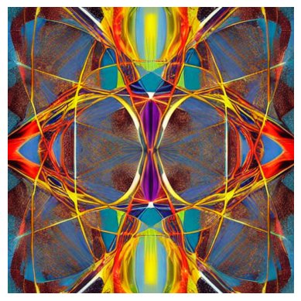
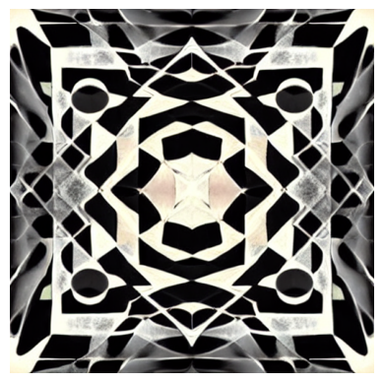
Automatic VS Semi Automatic
Classical songs were the most difficult to describe by the model.
MFCC values and tempo similar to the Pop Song.
The Semi Automatic approach provides better results in this scenario.
Abstract Automatic
Abstract Semi Automatic
Human refinement: “vibes of an old waltz dance”

Slide 24
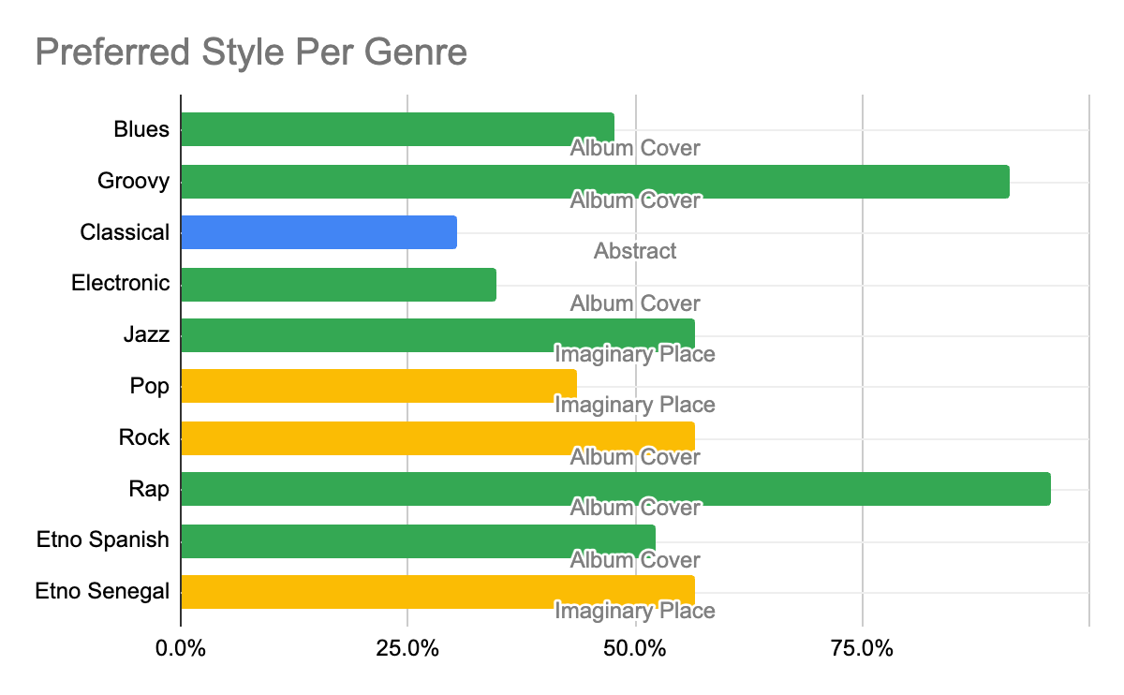
Identifying the Most Preferred Style Per Song
Album Cover Style dominates across multiple genres—suggesting a strong association between structured, thematic visuals and certain types of music.
Jazz, Pop, and Etno Senegal lean toward Imaginary Place—indicating these genres might evoke more conceptual, immersive imagery.
Abstract Style is only dominant in Classical music—which suggests that classical listeners perceive music more fluidly and conceptually.
No genre chose Diffuse Clouds Style—potentially indicating it doesn’t strongly resonate as a representation of music.
Notes:
📊 Key Findings from Dataset A:
1️⃣ Dominant Style Trends
Album Cover Style is the most preferred overall (selected in 6 out of 10 songs).
Imaginary Place Style is the second most preferred (3 out of 10 songs).
Abstract Style was chosen for only one song (Classical, 30.4%).
Diffuse Clouds Style was not selected as the most chosen style for any song.
2️⃣ Genre-Based Observations
Genres where Album Cover is the dominant choice: ✅ Blues, Groovy, Rock, Rap, Pop, Etno Spanish, Electronic → These genres might have a strong cultural or thematic connection to traditional album artwork. ✅ Rap (95.7%) and Groovy (91.3%) show an overwhelming preference for Album Cover, suggesting users associate these genres with bold, expressive visuals.
Genres where Imaginary Place is the dominant choice: ✅ Jazz, Pop, Etno Senegal → These genres might evoke more conceptual, atmospheric, or mood-driven associations.
Classical Music prefers Abstract Style (30.4%) ✅ This suggests that listeners associate classical music with more fluid, emotional, and conceptual visuals rather than concrete imagery.

Slide 25
Dominant Style Trends Across User Groups
Song | Casual Listeners | Avid Listeners | Visual Artists | No Background in Art | Art Hobbyist and Students
Blues | Album Cover | Album Cover | Album Cover | Album Cover | Diffuse Clouds
Groovy | Imaginary Place | Album Cover | Album Cover | Album Cover | Album Cover
Classical | Imaginary Place | Abstract | Imaginary Place | N/A | Abstract
Electronic | N/A | Album Cover | N/A | Abstract | Diffuse Clouds
Jazz | Imaginary Place | Imaginary Place | Abstract | Imaginary Place | Imaginary Place
Pop | Album Cover | Imaginary Place | Album Cover | Album Cover | Imaginary Place
Rock | Diffuse Clouds | Album Cover | Abstract | Album Cover | Album Cover
Rap | Imaginary Place | Album Cover | Album Cover | Album Cover | Album Cover
Etno Spanish | Album Cover | Album Cover | Album Cover | Album Cover | Album Cover
Etno Senegal | Imaginary Place | Imaginary Place | Imaginary Place | Imaginary Place | Diffuse Clouds
Album Cover Style is the most frequently chosen overall, especially among: - Casual Listeners, Avid Listeners, and No Background in Art - Highly dominant in Rap, Pop, Blues, and Etno Spanish
Abstract & Diffuse Clouds Styles appear less frequently, with: - Abstract being chosen by Visual Artists & Art Hobbyists. - Diffuse Clouds being chosen mostly by Art Hobbyists & Rock listeners.
Imaginary Place Style is strong among: - Jazz, Classical, and Etno Senegal listeners - Preferred more by Avid Listeners & Visual Artists
Notes:
Album Cover Style is the most frequently chosen overall, especially among: ✅ Casual Listeners, Avid Listeners, and No Background in Art ✅ Highly dominant in Rap, Pop, Blues, and Etno Spanish
Imaginary Place Style is strong among: ✅ Jazz, Classical, and Etno Senegal listeners ✅ Preferred more by Avid Listeners & Visual Artists
Abstract & Diffuse Clouds Styles appear less frequently, with: ✅ Abstract being chosen by Visual Artists & Art Hobbyists. ✅ Diffuse Clouds being chosen mostly by Art Hobbyists & Rock listeners.

Slide 26
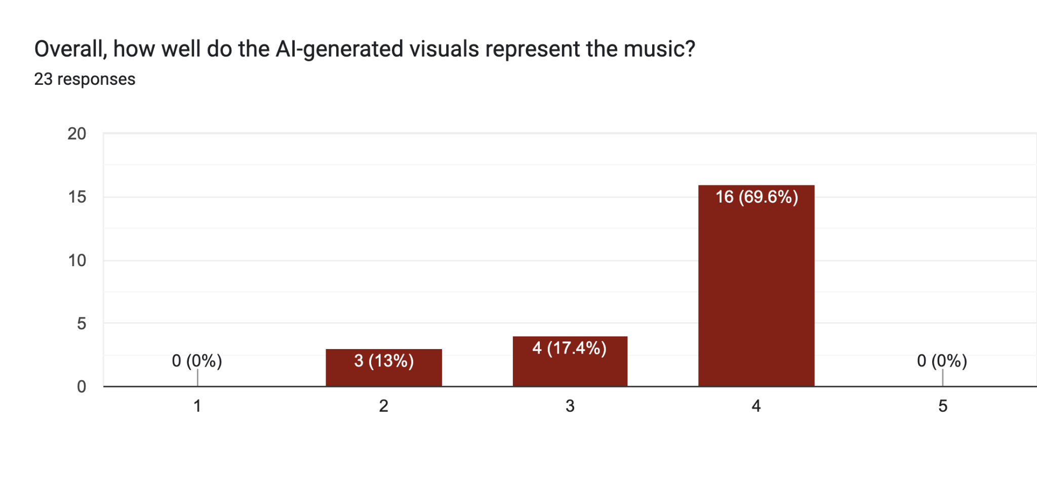
How Well Do AI-generated Visuals Represent The Music?
Bad
Very Well

Slide 27
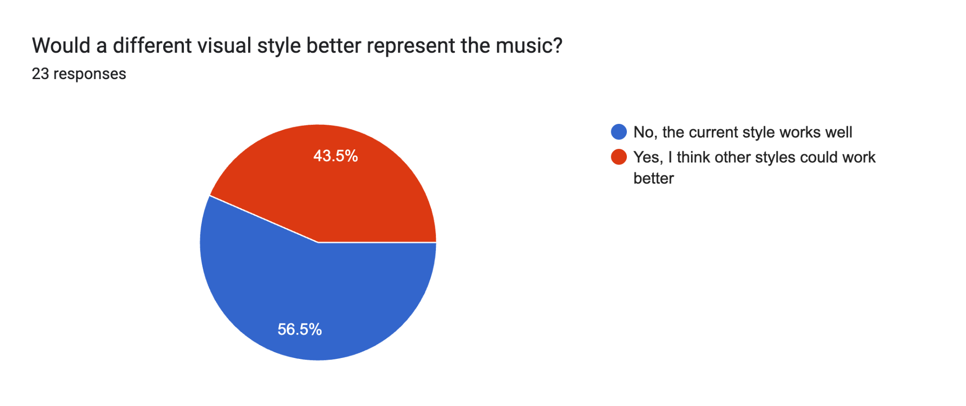
Would a Different Visual Style Better Represent The Music?

Slide 28
Alternative Style Ideas
💬 "In general, I prefer styles that open your mind because that way the music penetrates better inside you: styles where suggestive people or landscapes appear, not a simple colored image." 💬 "A style with people included more." 💬 "The style that includes more alive creatures maybe?"
💬 "Maybe something related to cups/glasses, like some songs may be a cocktail and others may be more coffee in a mug." 💬 "Something related to food, like different pizza toppings or sandwiches with different fillings." 💬 "Maybe there can be some relation to the bouba-kiki thing with words being more like one shape or another."
💬 "For the 4th song, maybe a more digital concept, 80-90s or vaporwave style could fit nicely."
💬 "I did find myself mostly focusing on the colors and shapes contained in the images, even the ones with clearer motives, so I guess maybe I think the more abstract styles could be explored further rather than trying new styles." 💬 "Maybe something that also includes chiaroscuro, impressionism, or baroque art, not only realist or abstract art."
💬 "Less abstract images communicate a bit better, I think." 💬 "Some arts visual feels completely different from the music (or maybe that I ain’t really understand the meaning behind the music and the art itself).”

Slide 29
Evaluating Alternative Style Preferences
New Style Possibilities Based on Feedback:
Figurative & Suggestive Styles → Introduce AI-generated visuals featuring people, landscapes, or recognizable elements.
Theme-Based Symbolic Styles → Experiment with food, drink, or shape-based metaphors (e.g., Bouba-Kiki effect).
Digital & Retro-Futuristic Styles → Add Vaporwave, Glitch Art, or Cyberpunk influences for electronic/digital music.
Classic Art Movements → Explore styles inspired by Baroque, Impressionism, or Chiaroscuro techniques.
Notes:
📝 Categorization of Feedback
1️⃣ Preference for Suggestive & Conceptual Styles
💬 "In general, I prefer styles that open your mind because that way the music penetrates better inside you: styles where suggestive people or landscapes appear, not a simple colored image." 💬 "A style with people included more." 💬 "The style that includes more alive creatures maybe?"
🔍 Key Insight:
Some participants prefer figurative elements like people, landscapes, or living creatures over purely abstract imagery.
AI could explore suggestive realism—blending abstract styles with recognizable forms (e.g., silhouettes, landscapes, or dreamlike figures).
2️⃣ Interest in Thematic & Symbolic Styles
💬 "Maybe something related to cups/glasses, like some songs may be a cocktail and others may be more coffee in a mug." 💬 "Something related to food, like different pizza toppings or sandwiches with different fillings." 💬 "Maybe there can be some relation to the bouba-kiki thing with words being more like one shape or another."
🔍 Key Insight:
Some participants suggest using metaphors or symbolic representations to reflect different moods of music.
AI could explore theme-based visuals where music is interpreted as everyday objects or food metaphors (e.g., coffee vs. cocktails for different moods).
Bouba-Kiki effect (associating rounder or sharper shapes with different sounds) could be applied to generate more intuitive, shape-driven visuals.
3️⃣ Desire for More Digital & Retro Styles
💬 "For the 4th song, maybe a more digital concept, 80-90s or vaporwave style could fit nicely."
🔍 Key Insight:
Retro-futuristic aesthetics like Vaporwave, 80s/90s digital art, or cyberpunk might resonate better with electronic or synth-based music.
AI could introduce Vaporwave / Glitch Art styles to see if they align with user preferences.
4️⃣ More Exploration of Abstract & Classical Art Styles
💬 "I did find myself mostly focusing on the colors and shapes contained in the images, even the ones with clearer motives, so I guess maybe I think the more abstract styles could be explored further rather than trying new styles." 💬 "Maybe something that also includes chiaroscuro, impressionism, or baroque art, not only realist or abstract art."
🔍 Key Insight:
Abstract styles remain effective for some participants, but traditional artistic movements (e.g., Impressionism, Chiaroscuro, Baroque) could be incorporated into AI prompts.
This suggests AI could refine existing abstract representations while experimenting with classical art influences.
Baroque (1600s–1750s)
Dramatic, grand, and highly detailed compositions
Strong contrasts between light and shadow
Rich, intense colors and dynamic movement
Example artists: Caravaggio, Rembrandt, Peter Paul Rubens
Impressionism (1860s–1890s)
Focus on capturing light, movement, and everyday life
Loose, visible brushstrokes and vibrant color palettes
Often painted outdoors (plein air) to capture natural light
Example artists: Claude Monet, Pierre-Auguste Renoir, Edgar Degas
Chiaroscuro (Light & Dark Contrast Technique)
Strong contrasts between light and dark to create depth and drama
Often used in Baroque paintings to emphasize subjects
Creates a three-dimensional effect with sharp shadows
Example artists: Leonardo da Vinci, Caravaggio, Rembrandt
In short, this phrase encourages you to experiment with elements like dramatic lighting (Chiaroscuro/Baroque), expressive colors and brushstrokes (Impressionism), or rich storytelling compositions (Baroque).

Slide 30
Next Steps for Refining AI Prompts
Modify AI training prompts to experiment with the suggested styles.
Run a small A/B test comparing abstract vs. figurative styles.
Survey participants again to see if these new styles improve their engagement.

Slide 31
Links to the codes
Automatic approach
Abstract Style
Imaginary Place
Diffuse Clouds
Album Cover
Semi-automatic approach
Semi-automatic

Slide 32
Q & A

